Slide 1
VOICE HOME AUTOMATION

Slide 2
Hello!
We are, Aakash & Sudeep
here to present our take on voice controlled home automation system.
You can find us @achavan4 & sgokarn1 @binghamton.edu

Slide 3
Agenda
Target problem
Components – Hardware/ Software
System Architecture
Programming Env & Software Library Tools
Challenges
Scope For Improvement

Slide 4
Target problem
1

Slide 5
All existing automation systems only control devices which already have wireless connectivity. None of the existing automation systems control old wired devices who don't have wireless connectivity
Many home automation systems are not cross-platform. They are tightly coupled to a specific operating system (like Android, iOS)
Existing Home automation systems support a specific set of devices. Configuring the system to control a newer device is a complex task

Slide 6
Hardware
2

Slide 7
Raspberry Pi (RPi2)
Connected to NodeMCU
Receives request from NodeMCU. It processes the request and takes necessary action (E.g turning LED ON/OFF)

Slide 8
NodeMCU
Provides wireless connectivity
Takes data from Raspberry Pi and controls sensors (E.g Neopixel LED)
NeoPixel LEDs
Digital LEDs compatible with Raspberry Pi
Will be connected to NodeMCU via wire connectors
Will receive a command from the NodeMCU and it will change its states as per commands

Slide 9
Software
3

Slide 10
IOS App
Uses I-OS Speech Recognition API to retrieve voice commands received
Interprets the text command received and Encodes it into machine recognizable (Sensor + Action) command
Sends the encoded data over Wireless channel

Slide 11
System Architecture
4

Slide 12
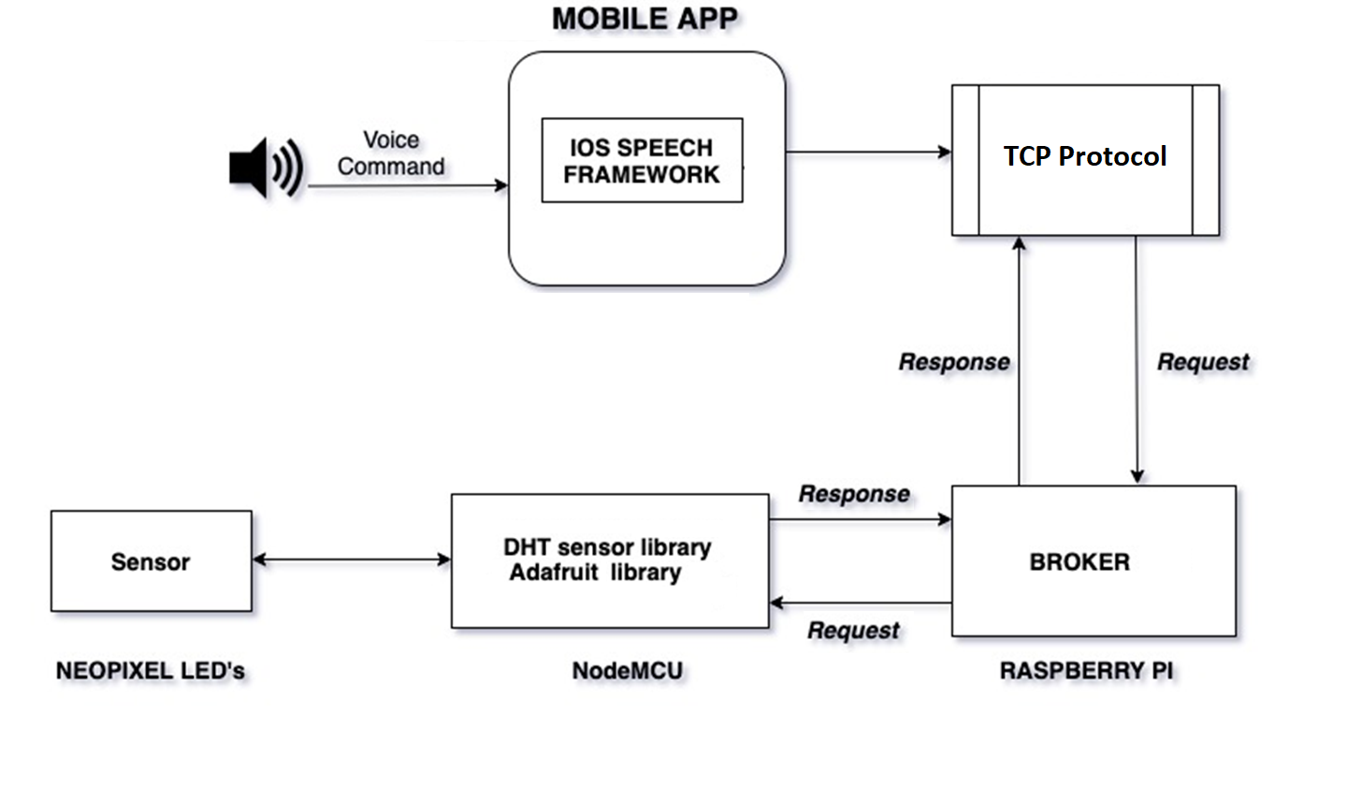

Slide 13
Programming Environment & Software Library Tools
5

Slide 14
Programming Environment
Geany IDE for Raspberry Pi
Arduino IDE for NodeMCU
Programming Language
C++ for programming Raspberry Pi
Swift for IOS Mobile App development
Software Library Tool
NodeMCU – DHTSensor.lib, Adafruit.lib
IOS Mobile App - Speech

Slide 15
Challenges
6

Slide 16
Implementing Multi-client Single Server functionality on Raspberry-Pi was a challenging task
In the initial development phase, our system could only understand a specific set of keywords. We implemented interpretation logic in the code so that any English sentence could be translated into an appropriate command which system could understand

Slide 17
Scope For Improvement
7

Slide 18
In future, additional devices like Fan, Air conditioner etc. could be added to the system
Currently, the Automation system is compatible with an iOS App. In future, we could develop an Android App/Website to make our system cross-platform
This system could be further enhanced by displaying the devices onto a map so that they could be tracked through the mobile app

Slide 19
Thanks!
Any questions?

